Slide 1
Application of Machine Learning and KNN Algorithm to Predict Ideal WIP
Micron Internship Final Presentation
Position : F16 ME PROD shift team intern
Name : Cheng-Yan Yang
Updated Aug 2022
Notes:
報告的主題是應用機器學習KNN演算法來預測ideal WIP

Slide 2
Outline
Introduction
Purpose
Method
Literature Review
KNN algorithms
Accuracy、MSE、R Square
Research Framework
Experimental Results
DE_LK3
PH_IMM
Conclusions and Future Research
Notes:
主要分為五個部分

Slide 3

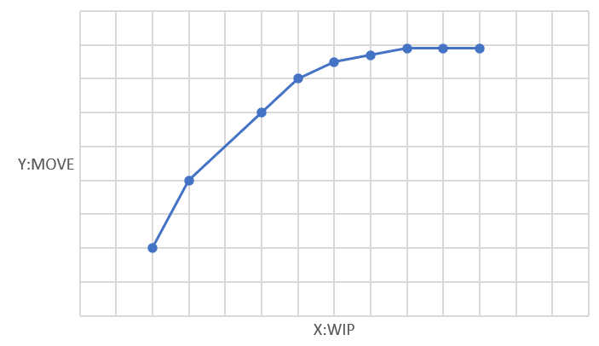
1. Introduction
During wafer fabrication, process data, equipment data will be automatically recorded and accumulated in database for monitoring the process, diagnosing faults.
However, in semiconductor manufacturing industry, many factors that are interrelated affect the yield of fabricated wafers.
Therefore, this study uses Machine Learning methods to analyze when WIP raise to a certain level, MOVE will approach saturation.
Notes:
首先還介紹一下為什麼會想做這個題目，就我的觀察，在半導體製造部非常看重生產指標，每天都會面對到各式各樣的數據，所以我就以指標為出發點去想有什麼指標是有關聯性，可以讓我用所學的理論基礎去支持人為的經驗判斷，在與mentor、M1主管的多次討論過後，最後決定探討WIP跟MOVE之間的關係。目前面對到的問題是我們WIP不斷往上增加但MOVE卻會增加到一定的量之後就會趨近飽和。

Slide 4
1. Introduction
Purpose: Hope to find ideal WIP through Machine Learning methods.
Methods: Using KNN algorithm and data analysis process to analyze and predict ideal WIP.
Analysis Tools: Python、SQL、Excel
Why choose KNN model? (Accuracy, MSE…)
What are the analysis variables? (WIP, MOVE)
How many data do we need in this research?
(One year data)
 | Accuracy | MSE | Data type
K Nearest Neighbors | 0.93 | 0.69 | Nonlinear
Linear Regression | 0.65 | 3.67 | linear
Support Vector Regression | 0.78 | 2.26 | Nonlinear
WIN
WIN
Notes:
研究目的:是希望透過實際資料分析去驗證我們到底WIP到哪個水位後，MOVE就會趨近飽和，就算下在多WIP，MOVE的極限值就在那。 研究方法:是透過機器學習中KNN演算法和資料前處理的手法，將資料清洗乾淨再透過model訓練，預測出我們的結果。
為何選擇KNN?
在ML方法中有非常多模型可以選擇，但每個模型都有各自優缺點，也需要針對面臨什麼問題去提出相對應演算法。而ML主要分為兩大問題，一個是解決分類問題一個是預測問題，這次研究屬於預測問題，所以就限縮在找尋回歸演算法，就比較了三個模型LR、SVR、KNNregresor，因為比較LR、SVR、KNN之後KNN預測準確度效果較佳，所以選擇KNN，後續會針對評估指標做完整介紹。
分析變數有哪些? 就目前的觀察影響的變數可能有
WIP、move
在這次研究我們需要多少資料? 我這邊是以過去一年的資料作為研究

Slide 5
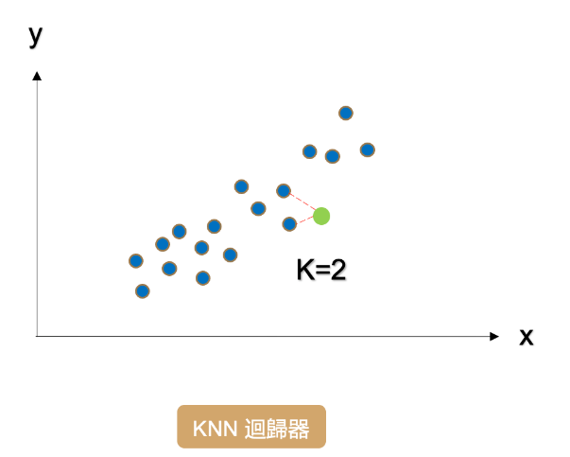
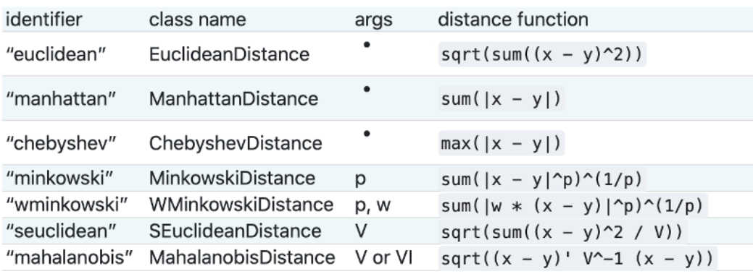
2. Literature Review - KNN algorithms
K Nearest Neighbors(KNN)
It belongs to one of the algorithms of Supervised learning in Machine learning.
Pros : The biggest advantage of k-NN is that it is easy to understand, and the performance is reasonable without too much adjustment.
Cons : The construction of the k-NN model is fast, but the prediction speed is slow when the number of features or data points in the training data is large.
Notes:
KNN 的全名 K Nearest Neighbor(K近鄰演算法) 是屬於機器學習中的 Supervised learning 其中一種算法，顧名思義就是 k 個最接近你的鄰居，當K=2可以看到綠色點(預測值)是依據最接近的兩個點所算出來的。那為什麼綠色點會在那個位置?是因為KNN是透過距離計算的公式所計算出來。以下七個都是距離計算的公式，最常用到的就是第一項歐式距離。
優點: KNN容易理解，效能表現也很好，不需要做太多的參數調整。主要調整的是K值跟距離公式的算法。
缺點:當資料變數過多時預測速度會很慢而且效果不好。

Slide 6
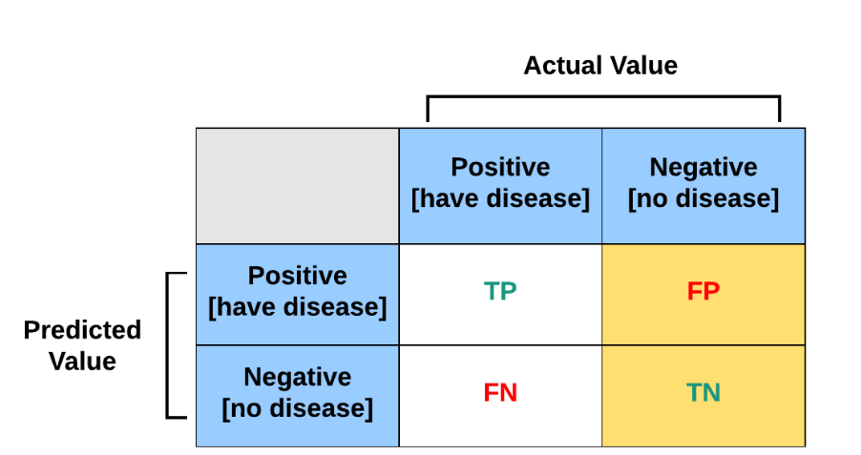
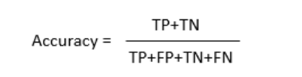
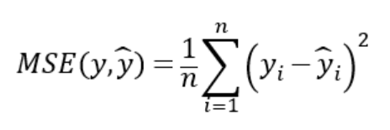
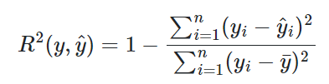
2. Literature Review
Accuracy、MSE、R Square
The accuracy is between 0 and 1, the closer to 1 the higher the accuracy of the model.
(accuracy > 0.7 are highly reliable)
MSE(Mean-Square Error) The smaller the error, the better。
R2（coefficient of determination）:The coefficient is between 0 and 1, and it is used to explain the percentage of explained variation in the total variation. The closer to 1 is the better.
(R2 > 0.8 are highly reliable)
Notes:
當我們在做回歸是做預測一個連續的值，這時候我們希望預測的值跟實際值越接近越好，以下三個指標是判斷模型好壞常見的指標。
ACC:準確度在0到1之間，越接近1代表模型準確度越高。
MSE:誤差越小越好
R2:係數在0到1之間，用來解釋可解釋之變異佔總變異的百分比，係數越接近1越好。

Slide 7
3. Research Framework
Train_Test_Split
Start
Definition X:WIP and Y:move
Model training
Checking missing value and outlier
SQL Data gathering
Metrics (Accuracy, MSE)
Scatter plot
Preliminary data processing through EXCEL
Result
Data standardization
Using Python load in data
Model training and outcome evaluation
End
Data collection
Data preprocessing
Notes:
這是我的研究架構流程，主要分為三大部分、資料蒐集、資料預處理、模型訓練結果評估
細項就從SQL撈取DATA在用excel做初步處理去除不必要的資料，然後我用的編譯器是jupy

Slide 8
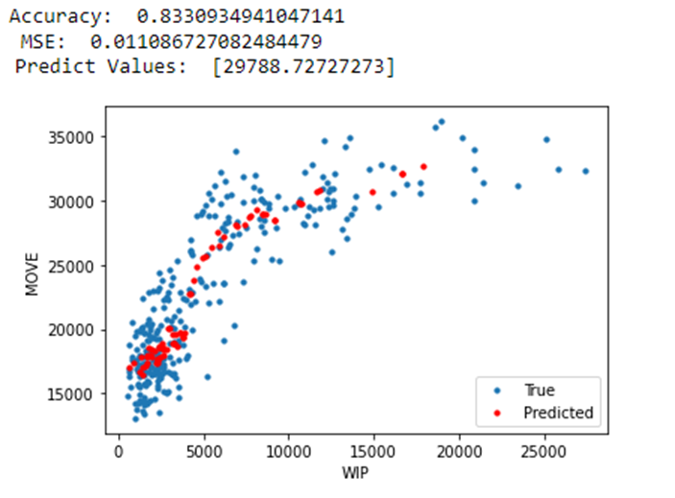
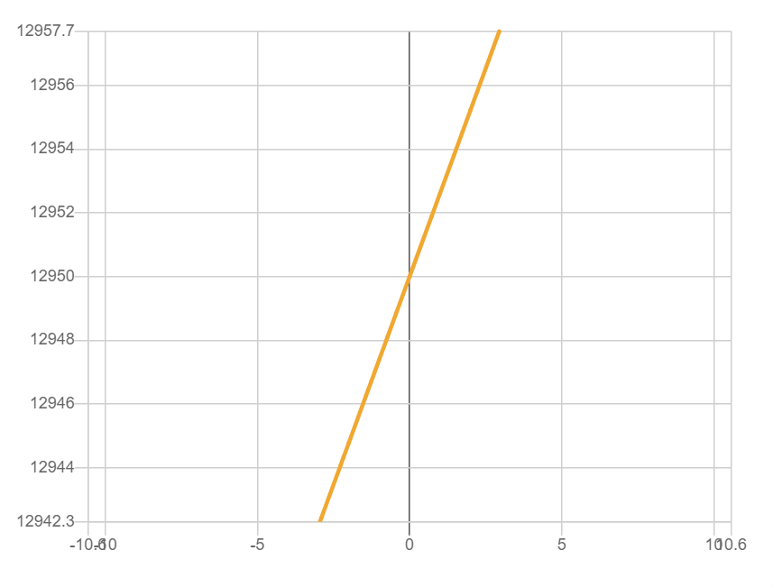
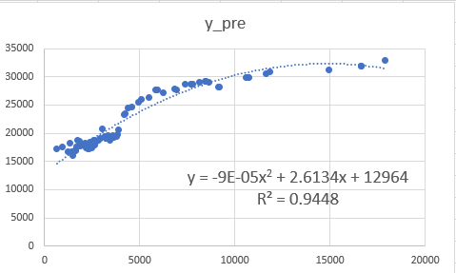
4. Experimental Results - DE_LK3
For example, we chose Dry Etch_LK3. When the accuracy of the KNN model is 80% and the MSE error is 0.011, we can know that the reasonable WIP is 12.95k. If the WIP exceeds 12.95k, the Move will approach saturation at 30k.
(Accuracy: 0.83 , MSE: 0.011 , R2: 0.94 , ideal WIP: 12.95k)
Notes:
我這邊就以LK3為例子
如何計算出個數字，先由model計算出來一組預測值，如中間圖所示，再來計算出方程式並對方程式做二階微分球極值，找到我們的IDEAL WIP 12.9

Slide 9
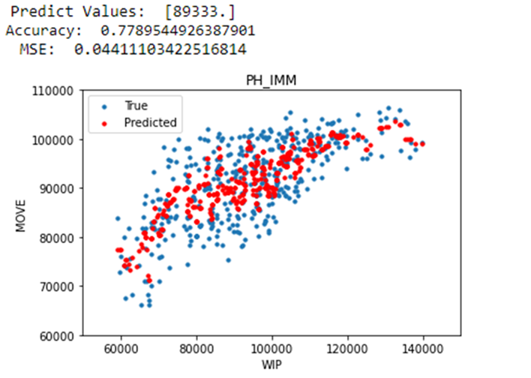
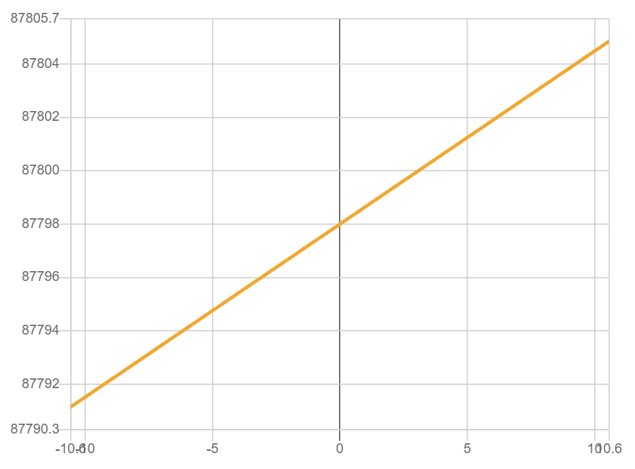
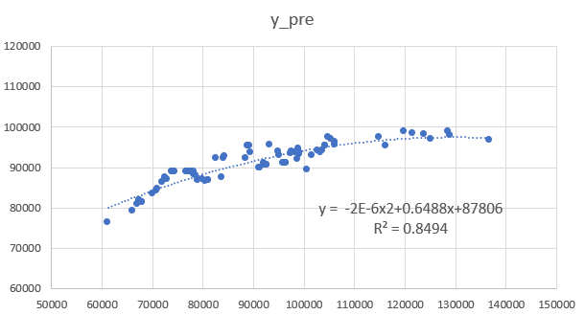
4. Experimental Results - PH_IMM
In PH_IMM. When the accuracy of the KNN model is 77.8% and the MSE error is 0.044, we can know that the reasonable WIP is 87.8k. If the WIP exceeds 87.8k, the Move will approach saturation at 90k.
(Accuracy: 0.77 , MSE: 0.044 , R2: 0.85 , ideal WIP: 87.8k)
Notes:
PH_IMM是全場瓶頸因此想對此作深入探討

Slide 10
5. Conclusions and Future Research
AREA | WSG | Ideal WIP
PH | IMM | 87.8K
Dry Etch | LK3 | 12.95K
The concept is extended to each WS of other Area, and the same analysis method is used to find the ideal WIP.
Add other factor analysis (MA、MU、idle、lost) ,using (Principal components analysis, PCA) Achieve data dimensionality reduction and find key factors.
Notes:
在結論與建議的部分，最後我們預測出來Ideal WIP分別在IMM有87.8K，LK3有12.95K，這是透過過去一年的歷史資料做分析，未來可以做2到3年在趨勢性上面可能會更加明顯，讓預測更加準確。
未來研究發展可以將這樣子的概念延伸到其他AREA的每個WS，用同樣分析手法去找到ideal WIP，最後再加總放大到每個AREA，最終到整個fab。
另外也可以加入其他影響因子(MA、MU、idle、lost)去做分析對於move的關係，可以套用其他統計手法ex.主成分分析去觀察在多個變數當中哪些自變數是影響應變數最大的，用最相關最少的關鍵因子去分析變數間的關係。

Slide 11
References
Math Solver : https://mathsolver.microsoft.com/zh-Hant
KNN回歸演算法 https://ithelp.ithome.com.tw/articles/10269826
資料分析流程 https://ithelp.ithome.com.tw/articles/10184905
機器學習 http://yltang.net/tutorial/dsml/12/
混淆矩陣 指標評估 https://jason-chen-1992.weebly.com/home/-confusion-matrix
https://medium.com/@s716419/%E6%A9%9F%E5%99%A8%E5%AD%B8%E7%BF%92%E6%A8%A1%E5%9E%8B%E8%A9%95%E4%BC%B0%E6%8C%87%E6%A8%99-confusion-matrix-precision-and-recall-e9d64ff14d81
Chien, C. F., Hsu, C. Y., & Hsiao, C. W. (2012). Manufacturing intelligence to forecast and reduce semiconductor cycle time. Journal of Intelligent Manufacturing, 23(6), 2281-2294..
Hsu, C. Y., Yang, C. S., Yu, L. C., Lin, C. F., Yao, H. H., Chen, D. Y., ... & Chang, P. C. (2015). Development of a cloud-based service framework for energy conservation in a sustainable intelligent transportation system. International Journal of Production Economics, 164, 454-461.
Chien, C. F., Hsu, C. Y., & Chen, P. N. (2013). Semiconductor fault detection and classification for yield enhancement and manufacturing intelligence. Flexible Services and Manufacturing Journal, 25(3), 367-388.

